Slide 1
CRIME ANALYSIS IN CHICAGO TEAM-16
Team Members
Devyani Deshmukh
Shivanvitha Konda
Sneha Alkuru
Vaishnavi Kankanala

Slide 2
Outline
Introduction
Original Data
Data pre-processing
Algorithms tested
Current work
Conclusion
References
Questions

Slide 3
Introduction
There are various crimes taking place in the city so we want to analyze the crime type that occurred most from 2010 to 2016 year and find if it is increased or decreased, and in which particular month it is increased.
Data is extracted from the Chicago Police Department's CLEAR (Citizen Law Enforcement Analysis and Reporting) system.

Slide 4
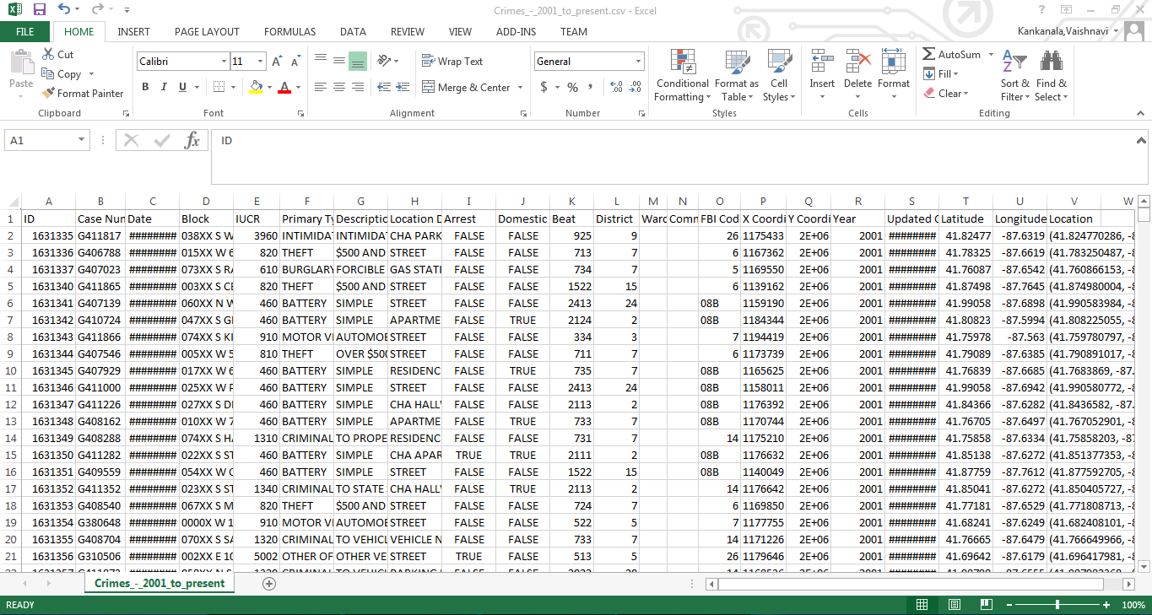
Original Data

Slide 5
S.No | Attribute Name | Description
1 | ID | Unique ID
2 | Case Number | Criminal activity number
3 | Date | Crime date
4 | Block | Place where crime happened
5 | IUCR | Illinois Uniform Crime Reporting (IUCR) codes are four digit codes that law enforcement agencies use to classify criminal
6 | Primary Type | Crime Type
7 | Description | Crime type description
8 | Location Description | Place description
9 | Arrest | Criminal arrested or not
10 | Domestic | Domestic violence
11 | Beat | A beat is smallest police geographical area
12 | District | Police district where incident occurred
13 | Ward | Ward place where it is occurred
14 | Community | Community area where Chicago has 77
15 | FBI code | Crime classification as outlined in FBI’s NIBRS
16 | X Coordinate | X coordinate of location
17 | Y Coordinate | Y coordinate of location
18 | Year | Case occurred year
19 | Updated On | Record was last updated
20 | Latitude | Location
21 | Longitude | Location
22 | Location | Location (Latitude, Longitude)

Slide 6
Data Preprocessing
Data Cleaning – Missing values replaced
Data Reduction – Dimensions and Instances
Data Transformation – Date format, Primary Type, Location Description, Arrest

Slide 7
Data
Original Data:
Dimensions – 22
Instances – 10,48,576
Preprocessed Data:
Dimensions – 7
Instances – 63,028
Notes:
2007 – 2009 -> instances 298
Now total instances – 63,326

Slide 8
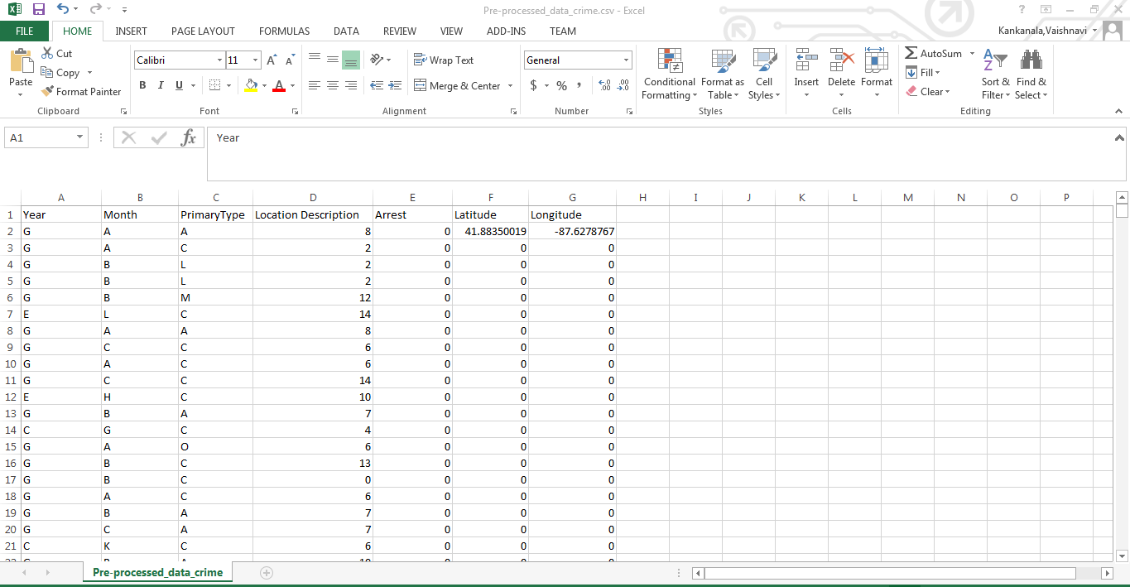
Pre-Processed Data

Slide 9
Attributes
Month
Primary Type (Crime Type)
Location Description
Year
Arrest
Latitude
Longitude

Slide 10
Data Transformation
Month:
Letter | Month
A | January
B | February
C | March
D | April
E | May
F | June
G | July
H | August
I | September
J | October
K | November
L | December

Slide 11
Letter | Year
A | 2010
B | 2011
C | 2012
D | 2013
E | 2014
F | 2015
G | 2016
Year:
Arrest:
Value | Arrest
False | 0
True | 1
Notes:
2007 – letter X
2008 – letter Y
2009 – letter Z

Slide 12
Primary Type:
Letter | Crime Type
A | theft,burglary,robbery
B | kidnapping
C | deceptive practice
D | motor vehicle
E | sexual
F | drugs
G | homicide
H | rules violation
I | gambling
J | interference with public
K | intimidation
L | battery
M | criminal damage
N | non-criminal
O | others

Slide 13
Location Description:
Letter | Crime Type
A | abandoned building
B | airport/aircraft
C | apartment
D | ATM
E | Bank
F | vehicle
G | residence
H | street, sidewalk
I | stores, restaurant
J | gas stations
K | Public places
L | parking lot
M | schools, colleges
N | cab, currency exchange
O | others

Slide 14
Algorithms Tested
J-48 (Decision Tree)
Multilayer Perceptron(Neural Network)
Random Forest
Naïve Bayes

Slide 15
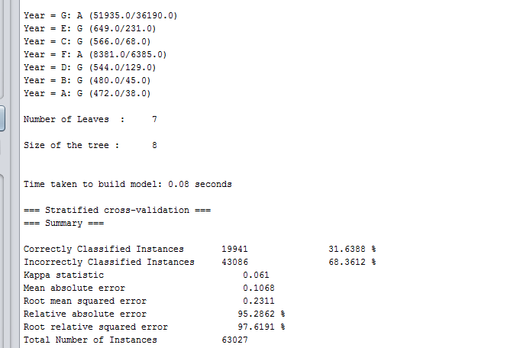
Year v/s Crime Type J-48 Decision Tree

Slide 16
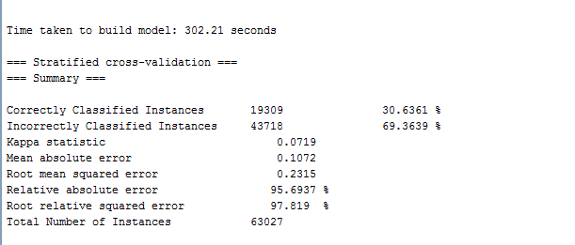
MultilayerPerceptron(Neural Network)

Slide 17
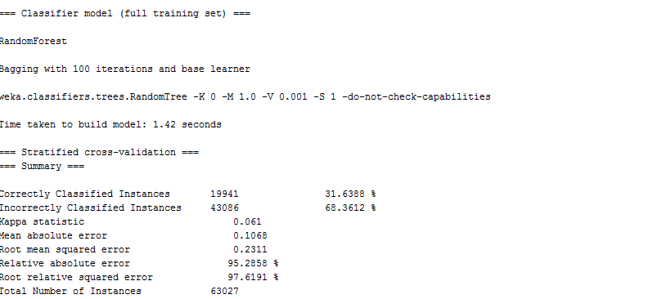
Random Forest

Slide 18
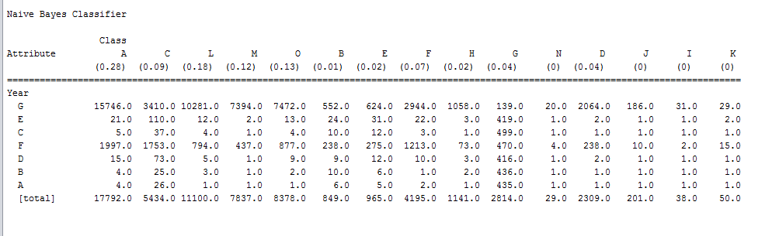
Naive Bayes

Slide 19
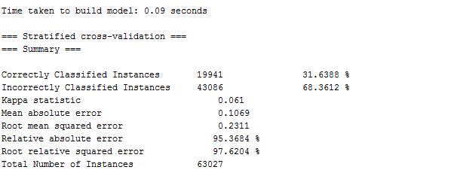
Naive Bayes Contd..

Slide 20
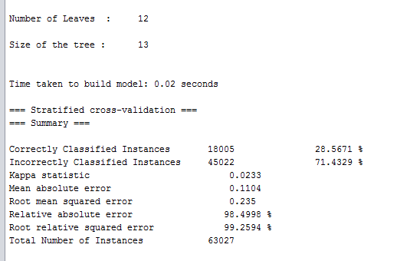
Month v/s Crime Type J-48 (Decision Tree)

Slide 21
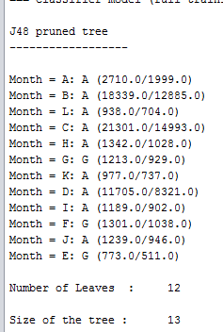
J-48 (Decision Tree) Contd..

Slide 22
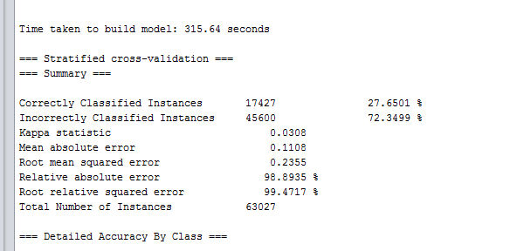
MultilayerPerceptron(Neural Network)

Slide 23
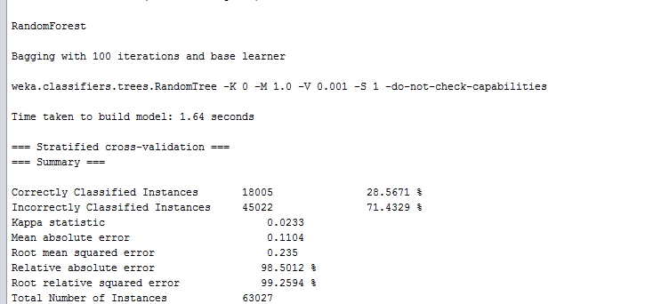
Random Forest

Slide 24
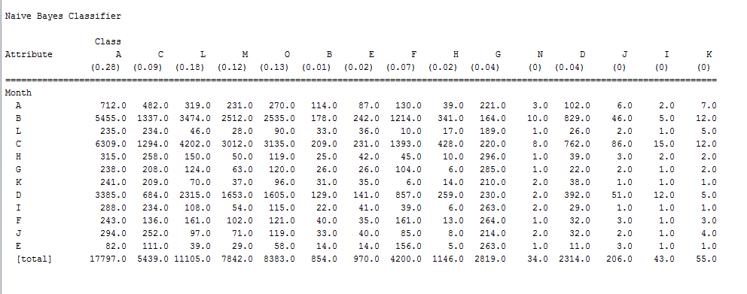
Naive Bayes

Slide 25
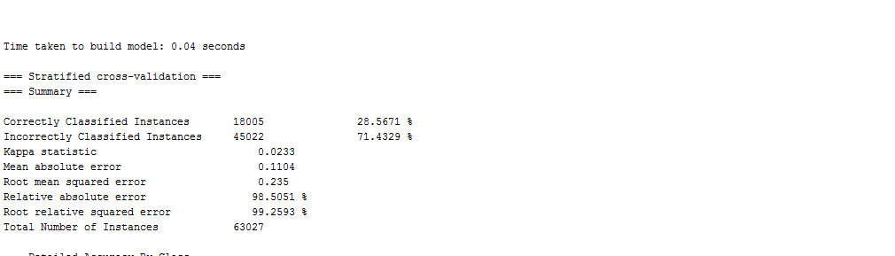
Naive Bayes Contd..

Slide 26
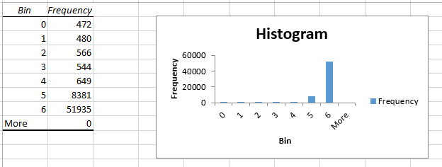
Histogram Analysis
Analysis of crime rate based on years

Slide 27
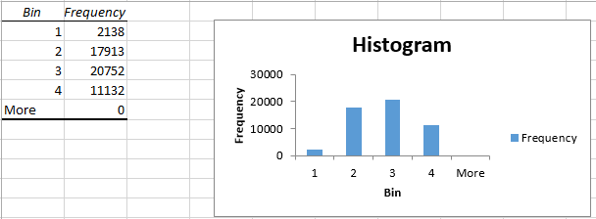
Histogram Analysis Contd..
Analysis of crime rate based on months in the year 2016

Slide 28
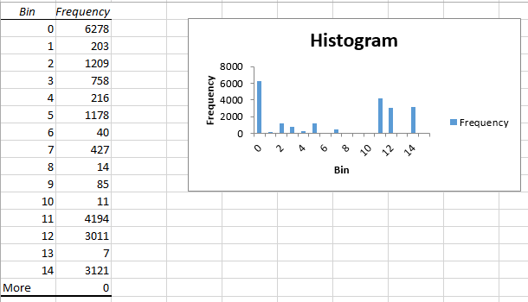
Histogram Analysis Contd..
Analysis of most occurring crime type in the month of March.

Slide 29
Conclusion
Equal accuracy for Decision tree, Random Forest and Naïve Bayes.
Accuracy is medium for neural network.
Based on these algorithms we concluded that crime type: theft is highest in 2016 and in the month of March in the city of Chicago.

Slide 30
Current Work Future Work
We are working on other algorithms to get more accurate outcome.
Work on to get the optimal results.
Analysis of 5 most crime zones in Chicago city.

Slide 31
References
Almanie, T., Mirza, R., & Lor, E. (2015). Crime prediction based on crime types and using spatial and temporal criminal hotspots. International Journal of Data Mining & Knowledge Management Process, Vol.15, No.4
https://arxiv.org/ftp/arxiv/papers/1508/1508.02050.pdf
https://catalog.data.gov/dataset/crimes-2001-to-present-398a4
http://www.cs.waikato.ac.nz/ml/weka/downloading.html
http://www.pentaho.com/download

Slide 32


Slide 33
Thank you

